Slide 1
MySQL Cluster
[NEC Group Internal Use Only]
OSS Technical Center
NEC Telecom Software Philippines

Slide 4
Table of Contents
1. Installation Procedure
2. Configuration
- Configuration Files
- Configuration Template
- Non-redundant Configuration
- Redundant Configuration
- Multi-Master Configuration
3. Initial Startup Procedure

Slide 5
MySQL Cluster Investigation

Slide 6
MySQL Cluster: Installation Procedure
There are many ways to install MySQL Cluster. Refer to the list below for the list of how to install MySQL Cluster.
Using the NDB Cluster Auto-Installer
Installation of NDB Cluster 7.5 on Linux
Using YUM repository (requires Internet connection)
Using NDB Cluster Binary Release for Linux
Using NDB Cluster from RPM
Using .deb Files
From Source on Linux
Installation of NDB Cluster on Windows
Using NDB Cluster Binary Release for Windows
From Source on Windows
In this section, installation procedure that will be use is using the YUM repository. Please refer to the attached file for the installation manual.

Slide 7
MySQL Cluster: Configuration
Configuration Files
NDB Cluster Configuration File (my.cnf) Each data node or SQL node requires a my.cnf file that provides two pieces of information: a connection string that tells the node where to find the management node, and a line telling the MySQL server on this host (the machine hosting the data node) to enable the NDBCLUSTER storage engine.
my.cnf: Specifies options for all NDB Cluster executables. This file must be accessible by each executable running in the cluster.
my.cnf: Found in /etc/ directory of data and SQL node after installation of MySQL Cluster.

Slide 8
MySQL Cluster: Configuration (Configuration Files – Cont…)
my.cnf file sections (enclosed with square brackets"[]") and parameters (anything under the square brackets).
[mysqld]
ndbcluster
enable ndbcluster storage engine
Parameter string in config file: “ndbcluster”
ndb-connectstring
provide connection string for management server host (default port is 1186)
Parameter string in config file: “ndb-connectstring=<mgm node ip address or hostname>[:<port_number>]”
[mysql_cluster]
ndb-connectstring
provide connection string for management server host (default port is 1186)
Parameter string in config file: “ndb-connectstring=<mgm node ip address or hostname>[:<port_number>]”
NOTE: Once you have started a mysqld process with the NDBCLUSTER and ndbconnectstring parameters in the [mysqld] in the my.cnf file as shown previously, you cannot execute any CREATE TABLE or ALTER TABLE statements without having actually started the cluster. Otherwise, these statements will fail with an error. This is by design.

Slide 9
MySQL Cluster: Configuration (Configuration Files – Cont…)
Default my.cnf in SQL node (after installation of MySQL Cluster)
# For advice on how to change settings please see
# http://dev.mysql.com/doc/refman/5.7/en/server-configuration-defaults.html
[mysqld]
#
# Remove leading # and set to the amount of RAM for the most important data
# cache in MySQL. Start at 70% of total RAM for dedicated server, else 10%.
# innodb_buffer_pool_size = 128M
#
# Remove leading # to turn on a very important data integrity option: logging
# changes to the binary log between backups.
# log_bin
#
# Remove leading # to set options mainly useful for reporting servers.
# The server defaults are faster for transactions and fast SELECTs.
# Adjust sizes as needed, experiment to find the optimal values.
# join_buffer_size = 128M
# sort_buffer_size = 2M
# read_rnd_buffer_size = 2M
datadir=/var/lib/mysql
socket=/var/lib/mysql/mysql.sock
# Disabling symbolic-links is recommended to prevent assorted security risks
symbolic-links=0
log-error=/var/log/mysqld.log
pid-file=/var/run/mysqld/mysqld.pid

Slide 10
MySQL Cluster: Configuration (Configuration Files – Cont…)
Default my.cnf in NDB node (after installation of MySQL Cluster)
[mysqld]
datadir=/var/lib/mysql
socket=/var/lib/mysql/mysql.sock
# Disabling symbolic-links is recommended to prevent assorted security risks
symbolic-links=0
# Settings user and group are ignored when systemd is used.
# If you need to run mysqld under a different user or group,
# customize your systemd unit file for mariadb according to the
# instructions in http://fedoraproject.org/wiki/Systemd
[mysqld_safe]
log-error=/var/log/mariadb/mariadb.log
pid-file=/var/run/mariadb/mariadb.pid
#
# include all files from the config directory
#
!includedir /etc/my.cnf.d

Slide 11
MySQL Cluster: Configuration Procedure (Configuration Files – Cont…)
Sample my.cnf in NDB node
[mysqld]
datadir=/var/lib/mysql-cluster
socket=/var/lib/mysql-cluster/mysql.sock
# Disabling symbolic-links is recommended to prevent assorted security risks
symbolic-links=0
# Settings user and group are ignored when systemd is used.
# If you need to run mysqld under a different user or group,
# customize your systemd unit file for mariadb according to the
# instructions in http://fedoraproject.org/wiki/Systemd
# Options for mysqld process:
ndbcluster # run NDB storage engine
[mysqld_safe]
log-error=/var/log/mariadb/mariadb.log
pid-file=/var/run/mariadb/mariadb.pid
#
# include all files from the config directory
#
!includedir /etc/my.cnf.d
[mysql_cluster]
# Options for NDB Cluster processes:
ndb-connectstring=192.168.50.51 # location of management server
# if setup has two management nodes, input the ip address of
# the two management node separated by a comma.

Slide 12
MySQL Cluster: Configuration Procedure (Configuration Files – Cont…)
Sample my.cnf in SQL node
# For advice on how to change settings please see
# http://dev.mysql.com/doc/refman/5.7/en/server-configuration-defaults.html
[mysqld]
#
# Remove leading # and set to the amount of RAM for the most important data
# cache in MySQL. Start at 70% of total RAM for dedicated server, else 10%.
# innodb_buffer_pool_size = 128M
#
# Remove leading # to turn on a very important data integrity option: logging
# changes to the binary log between backups.
log_bin=/var/lib/mysql-cluster/mysql-bin.log
#
# Remove leading # to set options mainly useful for reporting servers.
# The server defaults are faster for transactions and fast SELECTs.
# Adjust sizes as needed, experiment to find the optimal values.
# join_buffer_size = 128M
# sort_buffer_size = 2M
# read_rnd_buffer_size = 2M
datadir=/var/lib/mysql-cluster
port=3306
server-id=50
socket=/var/lib/mysql-cluster/mysql.sock
# Disabling symbolic-links is recommended to prevent assorted security risks
symbolic-links=0
log-error=/var/log/mysqld.log
pid-file=/var/run/mysqld/mysqld.pid
# Options for mysqld process:
ndbcluster # run NDB storage engine
[mysql_cluster]
# Options for NDB Cluster processes:
ndb-connectstring=192.168.50.51 # location of management server
# if setup has two management nodes, input the ip address of
# the two management node separated by a comma.
[client]
socket=/var/lib/mysql-cluster/mysql.sock

Slide 13
MySQL Cluster: Configuration (Configuration Files – Cont…)
NDB Cluster Global Configuration File (config.ini) The NDB Cluster global configuration file is by convention named config.ini(but this is not required). If needed, it is read by ndb_mgmd at startup and can be placed in any location that can be read by it. The location and name of the configuration are specified using --configfile=path_name with ndb_mgmd on the command line. This option has no default value, and is ignored if ndb_mgmd uses the configuration cache.
The management node needs a config.ini file telling it how many replicas to maintain, how much memory to allocate for data and indexes on each data node, where to find the data nodes, where to save data to disk on each data node, and where to find any SQL nodes.
config.ini: This file, sometimes known as the global configuration file, is read only by the NDB Cluster management server, which then distributes the information contained therein to all processes participating in the cluster. config.ini contains a description of each node involved in the cluster. This includes configuration parameters for data nodes and configuration parameters for connections between all nodes in the cluster.

Slide 14
MySQL Cluster: Configuration (Configuration Files – Cont…)
config.ini file sections (enclosed with square brackets"[]") and parameters (anything under the square brackets).
[ndbd_default]
NoOfReplicas
defines the number of replicas for each table stored in the cluster
Specifies the size of node groups
Default value is 2 and is recommended value for most production environments
DataMemory
defines the amount of space (in bytes) available for storing database records
memory allocated by DataMemoryis used to store both the actual records and indexes
IndexMemory
controls the amount of storage used for hash indexes in NDB Cluster
You can estimate the size of a hash index using this formula:
ServerPort
default port number that will be used by the data node
size = ( (fragments* 32K) + (rows* 18) ) * replicas

Slide 15
MySQL Cluster: Configuration (Configuration Files – Cont…)
[ndbd_mgmd]
HostName
defines the hostname of the computer on which the management node is to reside
DataDir
the directory where output files from the management server will be placed
default value for this parameter is the directory in which ndb_mgmd is located.
[ndbd]
HostName
defines the hostname of the computer on which the data node is to reside
Can either be the IP Address or the hostname of the machine if configured
NodeId
the node's address for all cluster internal messages
Each node in the cluster must have a unique identifier
DataDir
the directory where trace files, log files, pid files and error logs are placed.
the default is the data node process working directory
ServerPort
a port to connect to other nodes
Specify this parameter under [ndbd] section if you need to add a firewall rule to permit communication between nodes and if you have multiple data nodes
[mysqld]
HostName
- defines the hostname of the computer on which the SQL node (API node) is to reside

Slide 16
MySQL Cluster: Configuration Procedure (Configuration Files – Cont…)
Sample config.ini in MGM node
[ndbd default]
# Options affecting ndbd processes on all data nodes:
NoOfReplicas=2 # Number of replicas
DataMemory=80M # How much memory to allocate for data storage
IndexMemory=18M # How much memory to allocate for index storage
# For DataMemory and IndexMemory, we have used the
# default values. Since the "world" database takes up
# only about 500KB, this should be more than enough for
# this example NDB Cluster setup.
ServerPort=2202 # This the default value; however, you can use any
# port that is free for all the hosts in the cluster
# Note1: It is recommended that you do not specify the port
# number at all and simply allow the default value to be used
# instead
# Note2: The port was formerly specified using the PortNumber
# TCP parameter; this parameter is no longer available in NDB
# Cluster 7.5.
[ndb_mgmd]
# Management process options:
HostName=192.168.50.51 # Hostname or IP address of MGM node
DataDir=/var/lib/mysql-cluster # Directory for MGM node log files
[ndbd]
# Options for data node "A":
# (one [ndbd] section per data node)
HostName=192.168.50.55 # Hostname or IP address
NodeId=10 # Node ID for this data node
DataDir=/var/lib/mysql-cluster # Directory for this data node's data files
ServerPort=50501
[ndbd]
# Options for data node "B":
# (one [ndbd] section per data node)
HostName=192.168.50.56 # Hostname or IP address
NodeId=11 # Node ID for this data node
DataDir=/var/lib/mysql-cluster # Directory for this data node's data files
ServerPort=50502

Slide 17
MySQL Cluster: Configuration Procedure (Configuration Files – Cont…)
Sample config.ini in MGM node
[ndbd]
# Options for data node "C":
# (one [ndbd] section per data node)
HostName=192.168.50.59 # Hostname or IP address
NodeId=12 # Node ID for this data node
DataDir=/var/lib/mysql-cluster # Directory for this data node's data files
ServerPort=50503
[ndbd]
# Options for data node "D":
# (one [ndbd] section per data node)
HostName=192.168.50.60 # Hostname or IP address
NodeId=13 # Node ID for this data node
DataDir=/var/lib/mysql-cluster # Directory for this data node's data files
ServerPort=50504
[mysqld]
# SQL node options:
HostName=192.168.50.53 # Hostname or IP address
# (additional mysqld connections can be
# specified for this node for various
# purposes such as running ndb_restore)
NodeId=50
[mysqld]
# SQL node options:
HostName=192.168.50.54 # Hostname or IP address
# (additional mysqld connections can be
# specified for this node for various
# purposes such as running ndb_restore)
NodeId=51
[mysqld]
# Free mysqld

Slide 18
MySQL Cluster: Configuration
Configuration Template
Node or server setup
¹ Maximum number of NDB node in a cluster
² 4 ndb nodes per cluster (up to 48 ndb nodes per cluster)
config.ini (Management Node)
¹ Recommended value is 2
² Maximum number of ndb nodes
³ If server has firewall enabled, it is better to specify static server port value for each ndb node to be used in firewall rules setting
Node | Non-Redundant | Redundant (Minimum) | Multi-Master (within a cluster) | Multi-Master (within 2 clusters)
SQL | 1 | 2 | 2 | 2
NDB | 1 | 2 | 4 (up to 48¹) | 4 x 2 (up to 48 x 2¹)
Parameter | Non-Redundant | Redundant (Minimum) | Multi-Master (within a cluster) | Multi-Master (within 2 clusters)
NoOfReplica | Yes (Value: 1) | Yes (Value: 2) | Yes (Value: 1-4¹) | Yes (Value: 1-4¹)
ServerPort | Default | Incremental Value³ | Incremental Value³ | Incremental Value³

Slide 19
MySQL Cluster: Configuration
my.cnf (SQL Node)
my.cnf (NDB Node)
Please refer to the sample above. There is no specific changes in different setups in the configuration file in ndb node.
Parameter | Non-Redundant | Redundant (Minimum) | Multi-Master (within a cluster) | Multi-Master (within 2 clusters)
log_bin | NO | NO | NO | YES
server-id | OPTIONAL | OPTIONAL | OPTIONAL | YES

Slide 20
MySQL Cluster: Non-Redundant Configuration
In MySQL Cluster, there are three types of nodes which consists the minimal NDB Cluster configuration.
A minimal configuration consist of the following nodes:
Management node x 1
SQL node x 1
Data node x 1
NOTE: To meet the minimum of requirements for availability and safeguarding of data, multiple data node, at least 2, is needed.

Slide 21
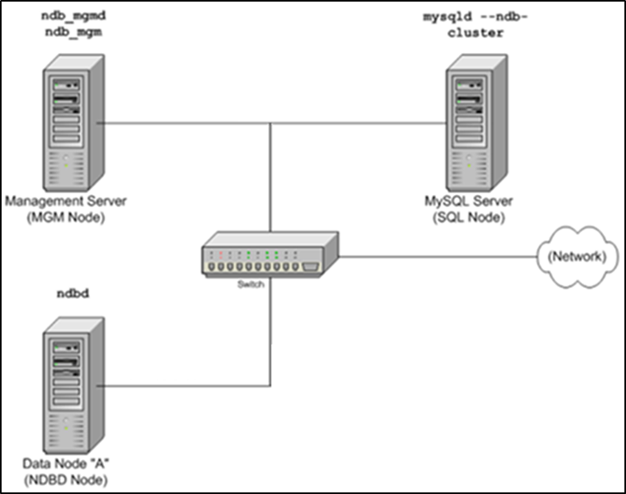
MySQL Cluster: Non-Redundant Configuration
Machine Setup

Slide 22
MySQL Cluster: Redundant Configuration
In MySQL Cluster, to meet the minimum of requirements for availability and safeguarding of data, multiple data node, at least 2, is needed.
A redundant configuration consist of the following nodes:
Management node x 1*
SQL node x 2*
Data node x 2
*These nodes can have only 1 server to meet the minimum requirement of highly available data.

Slide 23
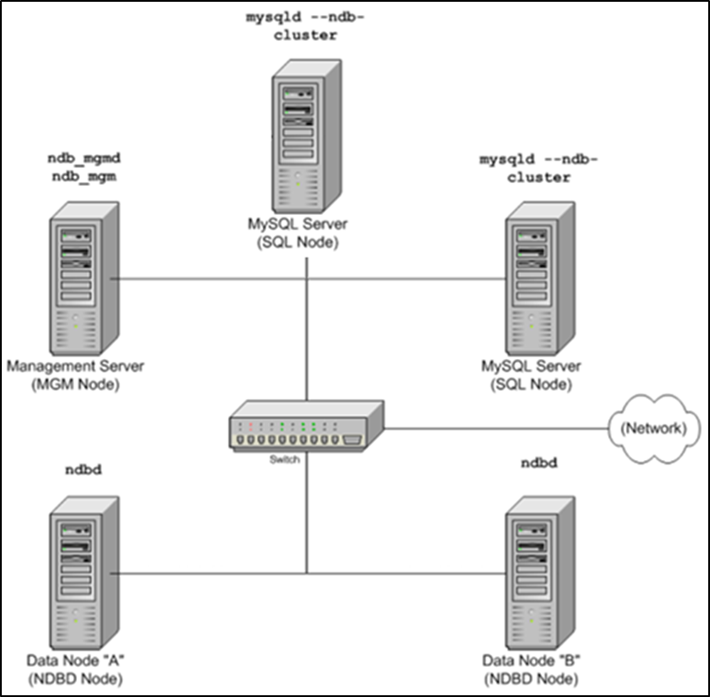
MySQL Cluster: Redundant Configuration
Machine Setup

Slide 24
MySQL Cluster: Multi-Master Configuration
In MySQL Cluster, it is possible to have more than 1 SQL server to perform updates, insert new records in the database. In a multi-master configuration, you can write from any SQL node in the cluster or from another cluster.
A redundant configuration consist of the following nodes:
Management node x 1*
SQL node x 2*
Data node x 2
*These nodes can have only 1 server to meet the minimum requirement of highly available data.

Slide 25
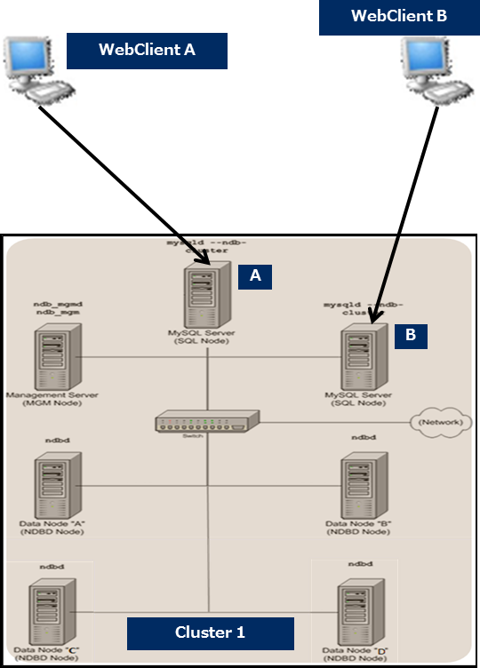
MySQL Cluster: Multi-Master Configuration
Machine Setup (1 Cluster Multi-Master Setup)
In Cluster 1, there are two master SQL nodes. SQL Node A can perform SQL operations (Insert, Update, Delete) to the database as well as SQL Node B.

Slide 26
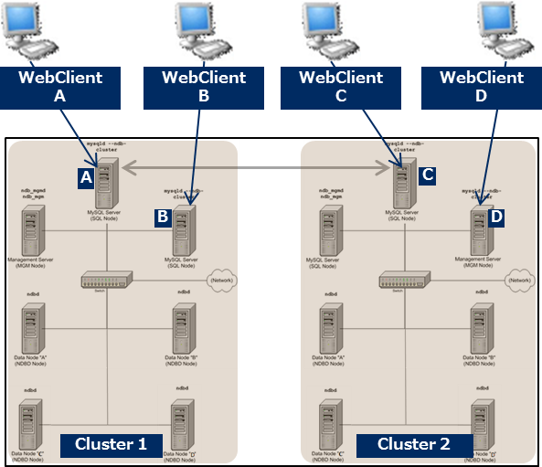
MySQL Cluster: Multi-Master Configuration
Machine Setup (Two Cluster Multi-Master Setup)
In a two cluster setup, all SQL Nodes can make changes in database. In this setup, any changes in the database done via SQL Node A will be reflected in Cluster 2 and can be retrieved via SQL Node C and D. Changes can also be retrieved via SQL Node B. When changes are done in Cluster 2, it will also be accessible in Cluster 1.

Slide 27
MySQL Cluster: Configuration
Two Cluster Multi-Master Configuration
Master in Cluster 1
Add the log_bin parameter in the configuration file my.cnf in SQL node.
log_bin=<path to binlog file>
server-id=<server id>
Restart the mysqld process
In mysql client
Create user for replication and grant privileges
CREATE USER ‘repl50’@’%’ IDENTIFIED BY ‘Repl123!’;
GRANT REPLICATION SLAVE ON *.* TO ‘repl50’@’%’ IDENTIFIED BY ‘Repl123!;
FLUSH PRIVILEGES;
Check master status
SHOW MASTER STATUS \G;
Copy the value of file, it will be use as input in the master in Cluster 2

Slide 28
MySQL Cluster: Configuration
Master in Cluster 2
Add the log_bin parameter in the configuration file my.cnf in SQL node.
log_bin=<path to binlog file>
server-id=<server id>
Restart mysqld
In MySQL Client
Stop slave threads
STOP SLAVE;
Set master configuration in slave node (Master in Cluster 2 is the Slave node of Master in Cluster 1)
CHANGE MASTER TO master_host=‘hostname’, master_user=‘<master replication username’, master_password=‘master replication password’, master_log_file=‘<refer to value of File in show master status execution in Master in Cluster 1>’, master_log_pos=‘<refer to value of Position in show master execution in Master in Cluster 1>;
Start the slave thread
START SLAVE;
Check the slave thread is running
SHOW PROCESSLIST;
\
Check slave thread status
SHOW SLAVE STATUS;

Slide 29
MySQL Cluster: Configuration
…show slave status output

Slide 30
MySQL Cluster: Configuration Procedure
…show slave status output

Slide 31
MySQL Cluster: Configuration Procedure
Master in Cluster 2
Create user for replication and grant privileges
CREATE USER ‘repl650’@’%’ IDENTIFIED BY ‘Repl123!’;
GRANT REPLICATION SLAVE ON *.* TO ‘repl60’@’$’ IDENTIFIED BY ‘Repl123!;
FLUSH PRIVILEGES;

Slide 32
MySQL Cluster: Configuration
Master in Cluster 1
Confirm connection is established
netstat –natp | egrep –I established.*mysql
Check the thread for master, confirm state is “Master has sent all binlog to slave…”
SHOW PROCESSLIST;
Stop the slave thread
STOP SLAVE;
Set master configuration in slave node (Master in Cluster 1 is the Slave node of Master in Cluster 2)
CHANGE MASTER TO master_host=‘hostname’, master_user=‘<master replication username’, master_password=‘master replication password’, master_log_file=‘<refer to value of File in show master status execution in Master in Cluster 1>’, master_log_pos=‘<refer to value of Position in show master execution in Master in Cluster 1>;
Start the slave thread
START SLAVE;
Check the slave status, check details must be pointing to Master in Cluster 2
SHOW SLAVE STATUS;

Slide 33
MySQL Cluster: Configuration Procedure
…show slave status output

Slide 34
MySQL Cluster: Configuration Procedure
…show slave status output

Slide 35
MySQL Cluster: Startup Procedure
Startup Procedure
Starting the management node(s)
Execute: ndb_mgmd -f /var/lib/mysql-cluster/config.ini --skip-config-cache*
If firewall is enabled, add rules to allow incoming messages through port 1186 (default port used by management server daemon).
*Option –skip-config-cache is to not to create config cache so that every time ndb_mgmd will be started, config file should be specified to make sure that udpates in the config file is reflected.
Starting the data nodes
Create first the directory specified in DataDir parameter of config.ini file in the management node.
If firewall is enabled, add rules to allow incoming messages through server port set in config.ini file.
Execute: ndbd –initial*
*This option causes all files to be removed from the NDB Cluster file system and all redo log files to be re-created. It is permissible to use this option when starting the cluster for the very first time (that is, before any data node files have been created); however, it is not necessary to do so.

Slide 36
MySQL Cluster: Startup Procedure
3. Starting the SQL nodes
Disable the mysqld.service so that it will not be started during reboot: systemctl disable mysqld.service
Run mysqld process using the mysqld binary for initialization of mysql server:
Execute: mysqld –user=“mysql” –initialize &
If you intended to create a user aside from root, use that username to initialize the mysql server so that permission issues when accessing or using mysql server files will be avoided.
After initialization, retrieve temporary password generated
Execute: grep ‘temporary password’ /var/log/mysqld.log
Output: 2017-05-16T06:32:12.547064Z 1 [Note] A temporary password is generated for root@localhost: wLMN%vrwn00h
Re-run mysqld process
Execute: mysqld –user=“mysql” &
Change root password and create mysql user for mysql server in mysql client
Execute: root# mysql –u root –p
Input temporary password
Login successful in mysql client.
In mysql client,
Change root user: ALTER USER 'root'@'localhost' IDENTIFIED BY ‘<NEW PASSWORD>';
Create user mysql: CREATE USER 'mysql'@'localhost' IDENTIFIED BY ‘< NEW USER PASSWORD>‘;
Grant privileges to new user: GRANT ALL PRIVILEGES ON * . * TO 'mysql'@'localhost';
Flush privilegs: FLUSH PRIVILEGES;
Confirm successful update of root password
Execute: mysql –u root –p
Input updated password and confirm successful login.
Confirm successful creation of new user
Execute: mysql –u mysql –p
Input password and confirm successful login.

Slide 37
MySQL Cluster: Startup Procedure
Confirm node startup
Execute the following in MGM Node: ndb_mgm –e SHOW
[root@mgm-node-01 ~]# ndb_mgm -e SHOW
Connected to Management Server at: localhost:1186
Cluster Configuration
---------------------
[ndbd(NDB)] 4 node(s)
id=10 (not connected, accepting connect from 192.168.50.55) << ndbd started must be running
id=11 (not connected, accepting connect from 192.168.50.56) << ndbd started must be running
id=12 (not connected, accepting connect from 192.168.50.59) << ndbd started must be running
id=13 (not connected, accepting connect from 192.168.50.60) << ndbd started must be running
[ndb_mgmd(MGM)] 1 node(s)
id=1 @192.168.50.51 (mysql-5.7.18 ndb-7.5.6) << ndb_mgmd started must be running
[mysqld(API)] 3 node(s)
id=50 (not connected, accepting connect from 192.168.50.53) << mysqld started must be running
id=51 (not connected, accepting connect from 192.168.50.54) << mysqld started must be running
id=52 (not connected, accepting connect from any host) << free api node for other ndb cluster connections
[root@mgm-node-01 ~]#

